Slide 1
TECHNICAL ENVIRONMENT SYSTEMS
REPORT
2018-2019
POLITECNICO DI MILANO
PROFESSOR:
RENZO MARCHESI
GROUP MEMBERS:
LAN WEI
JIAN HUANG
HASHEMIAN DALLOOEE

Slide 2
TECHNICAL ENVIRONMENT SYSTEMS-REPORT
CONTENT
INTRODUCTION
BUILDING
PIACENZA-BASIC WALL
PIACENZA-WALL 1
PIACENZA-WALL 2
PARIS-WALL 2
OSLO-WALL 2
SUMMARY

Slide 3
TECHNICAL ENVIRONMENT SYSTEMS-REPORT
INTRODUCTION
The report is to research the internal energy of building with different exterior walls in different cities. We made one building
and put it into three cities-PIACENZA,PARIS,OSLO to test its energy performances . In the first three cases, we analyzed three
exterior walls in PIACENZA, one is the basic wall, the others are new walls . The last two cases are in the other cities with one
of the new wall. At last, we summarized the results and compared the energy performances of the building with different exterior walls in one city and it with the same exterior wall in different cities
BUILDING
PIACENZA PARIS OSLO
ENERGY PERFORMANCE ?
BASIC WALL WALL 1 WALL 2

Slide 4
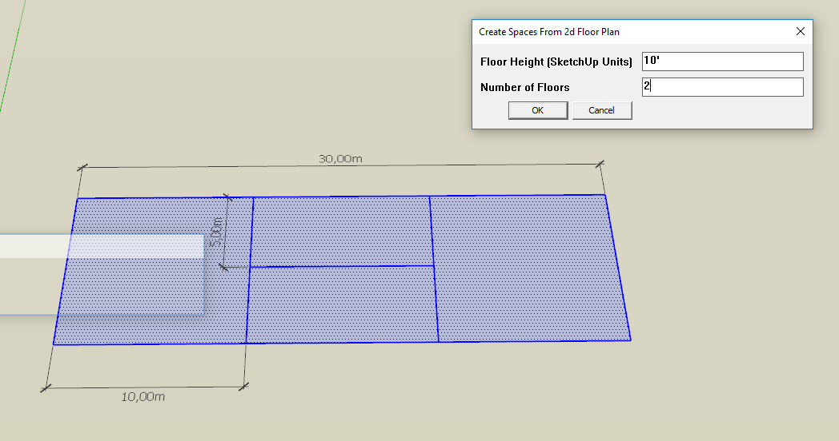
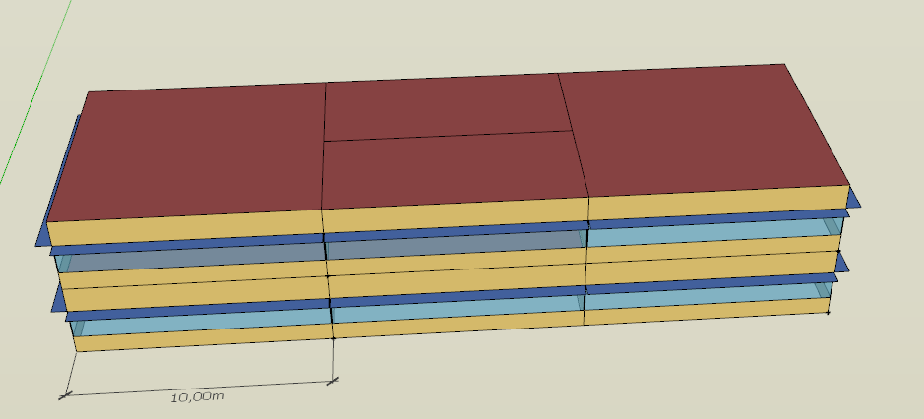
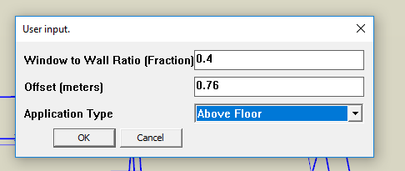
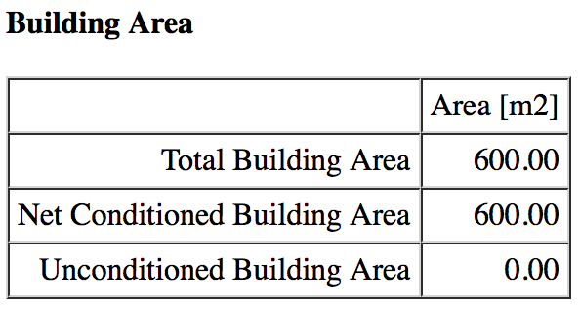
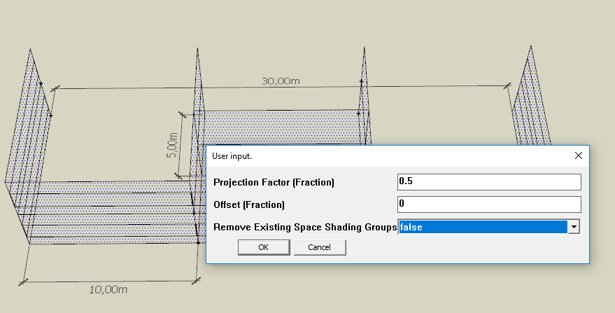
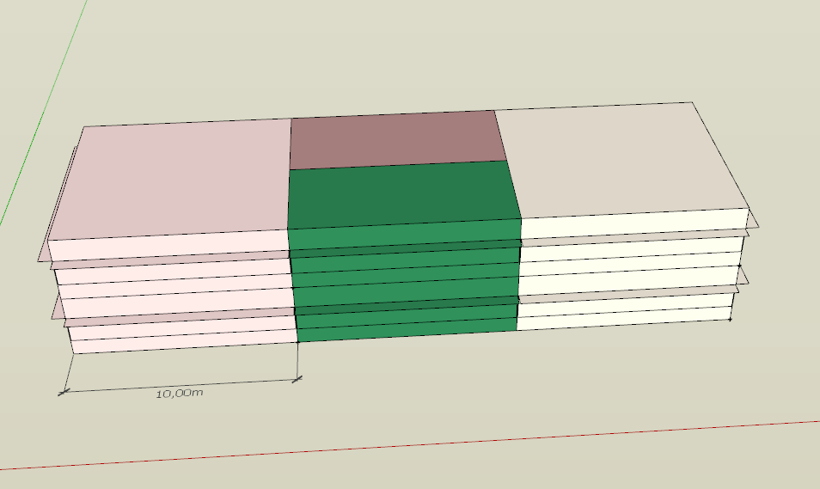
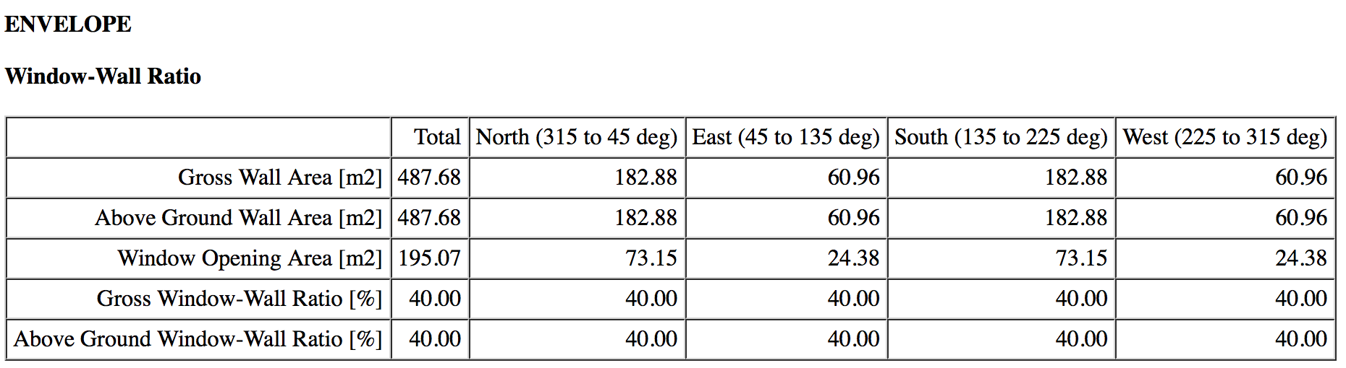
TECHNICAL ENVIRONMENT SYSTEMS-REPORT
BUILDING
We made an office building in this case which is 30 meters
long,10 meters wide and 10 meters high. The total building
area has 600 square meters . This building has two floors
and has some simple structure . It is surrounded by walls
and glasses.
Thermal zones
Open offices / Break Room / Stairs

Slide 5
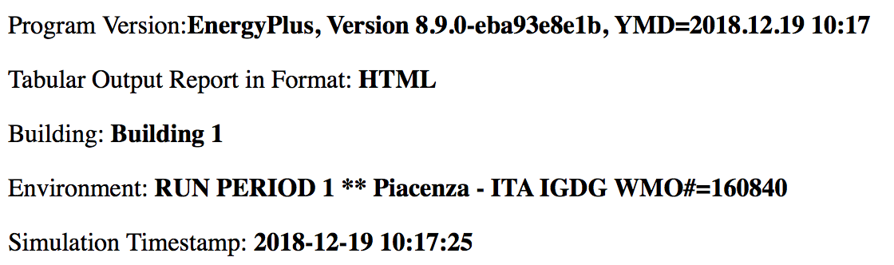
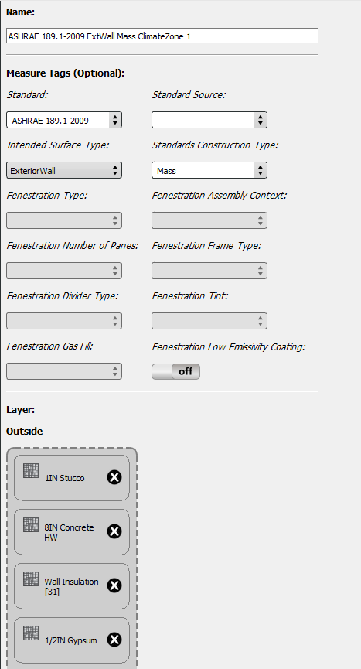

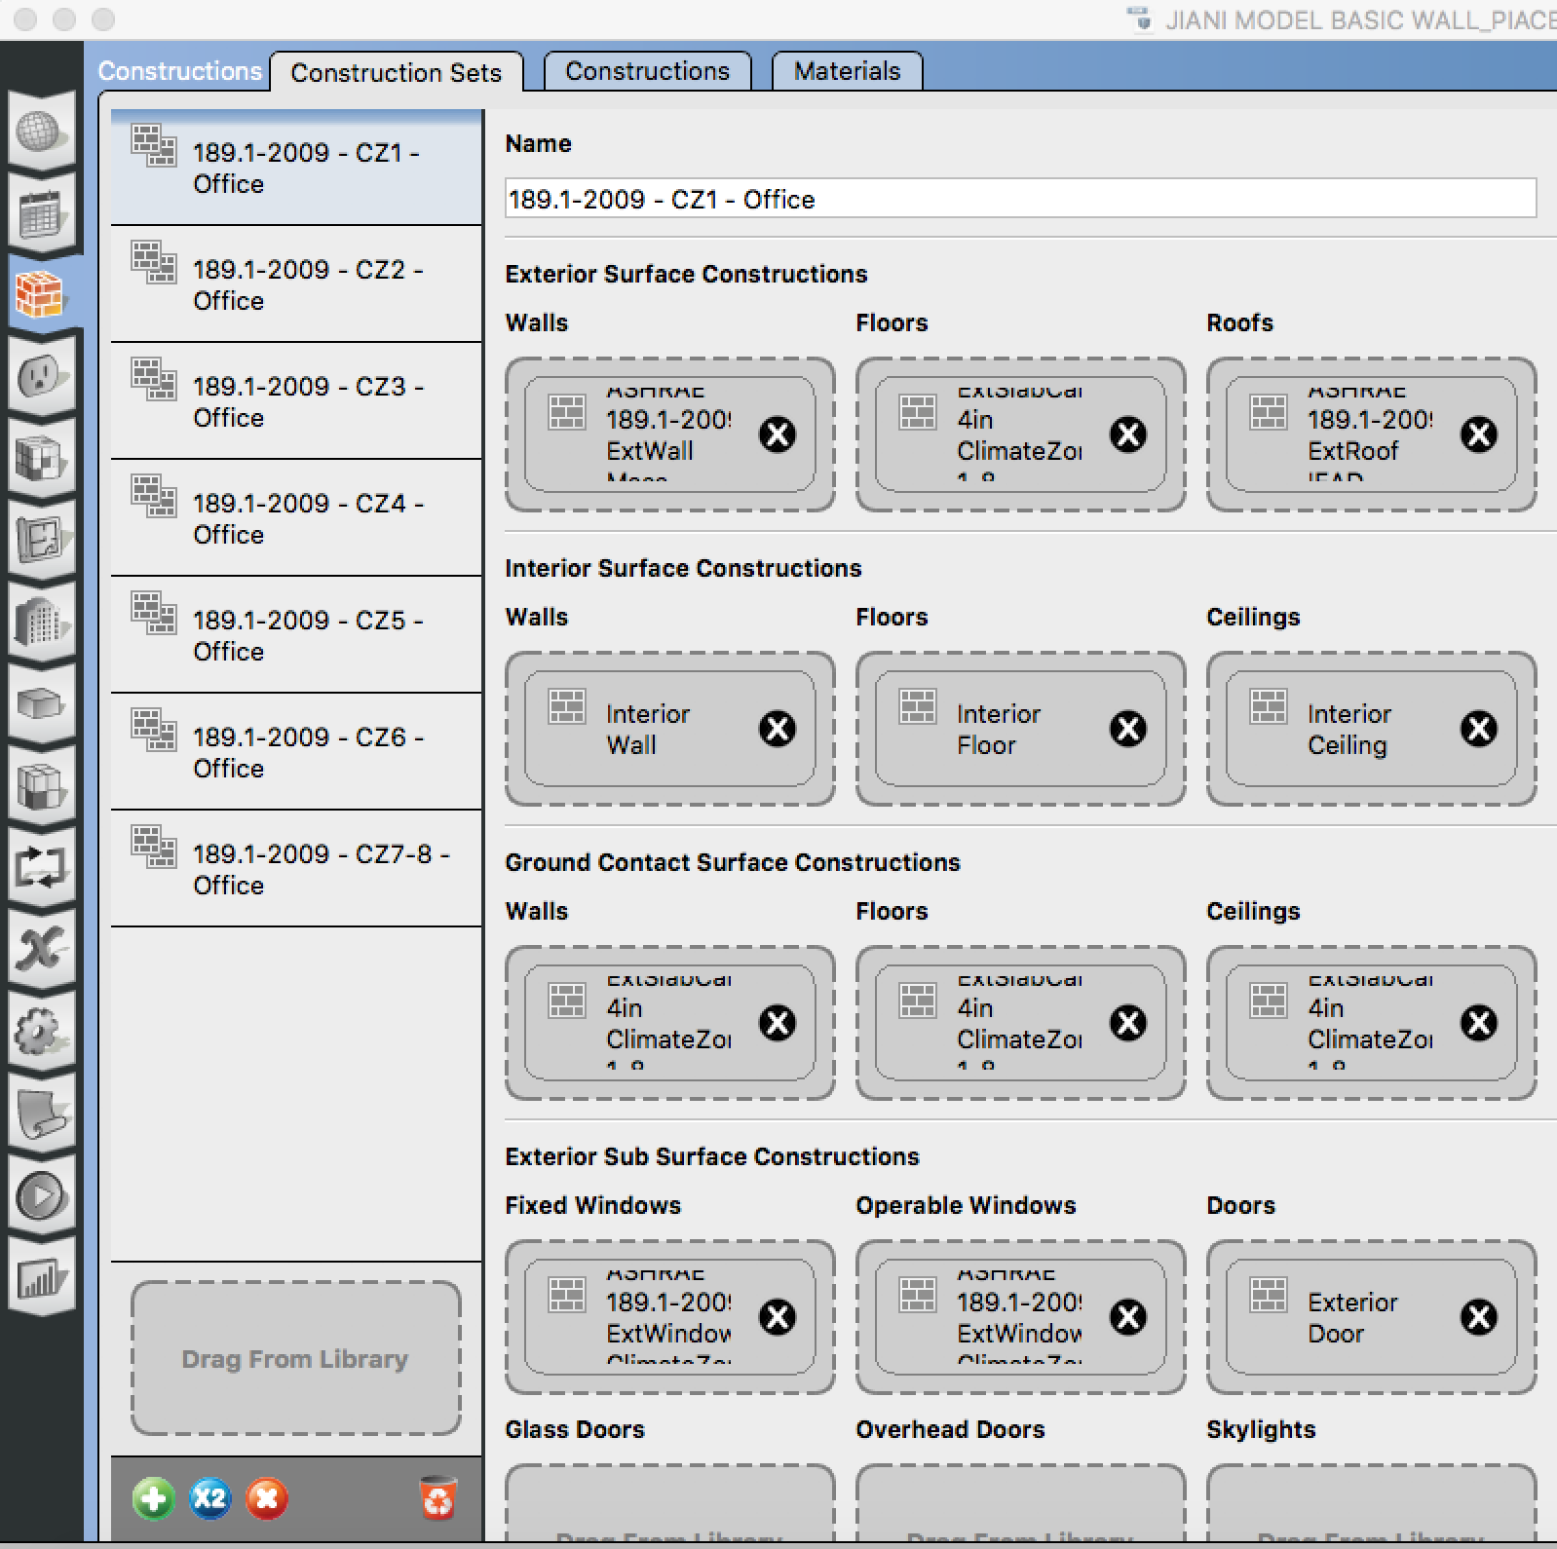
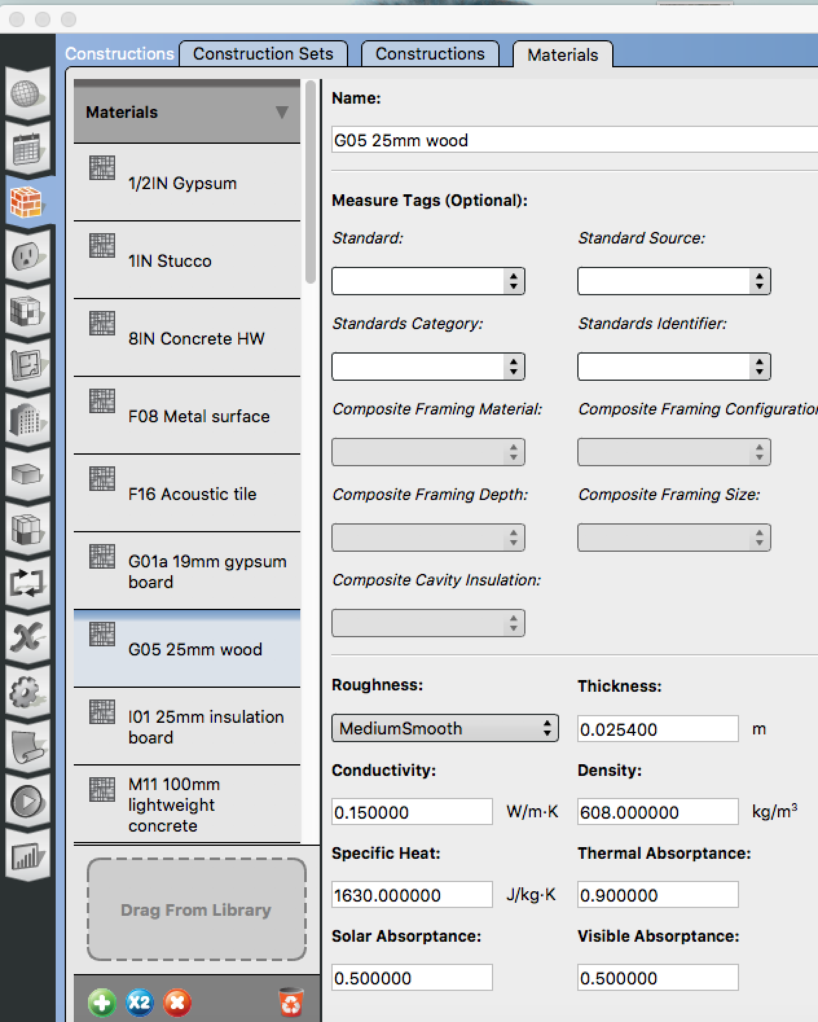
TECHNICAL ENVIRONMENT SYSTEMS-REPORT
PIACENZA-BASIC WALL
BASIC WALL : Stucco (2,5cm) / Concrete (20cm) / Insulation (3cm) / Gypsum (1.3cm)

Slide 6
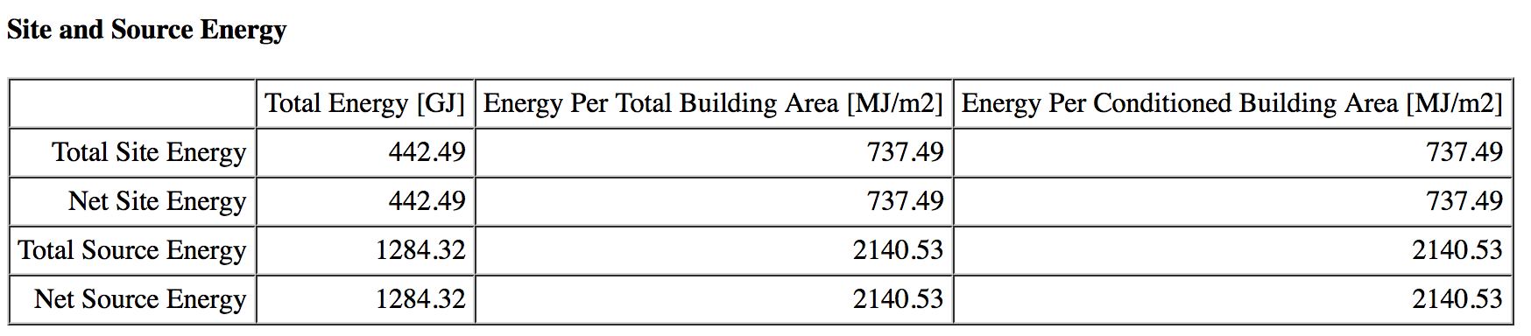
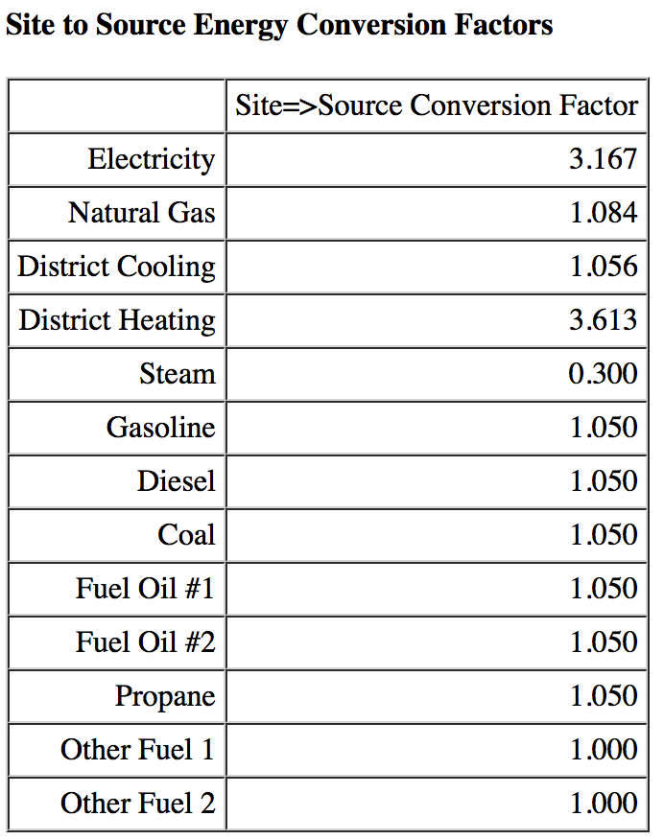
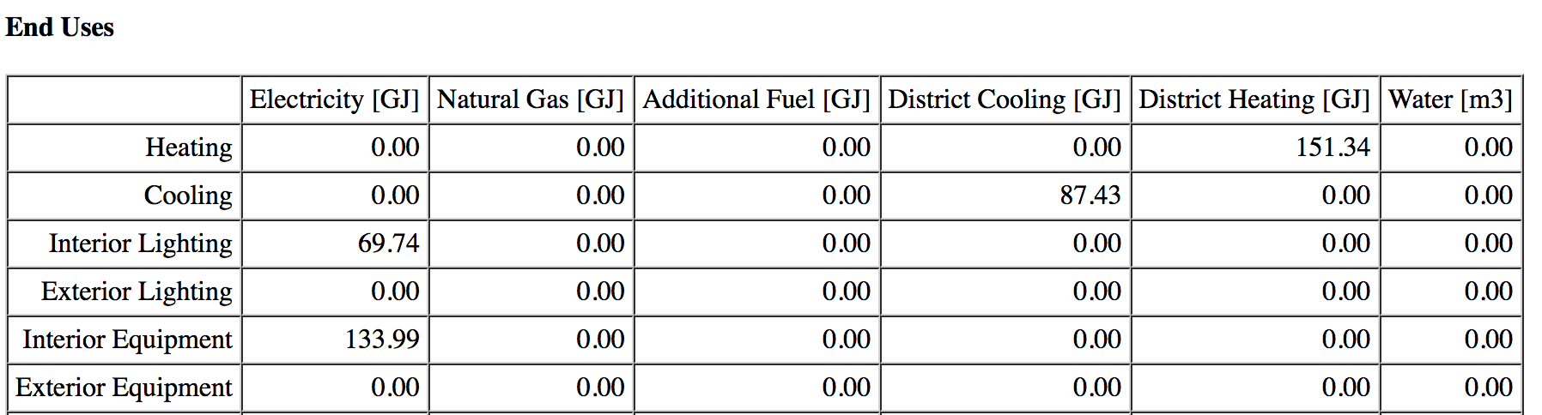
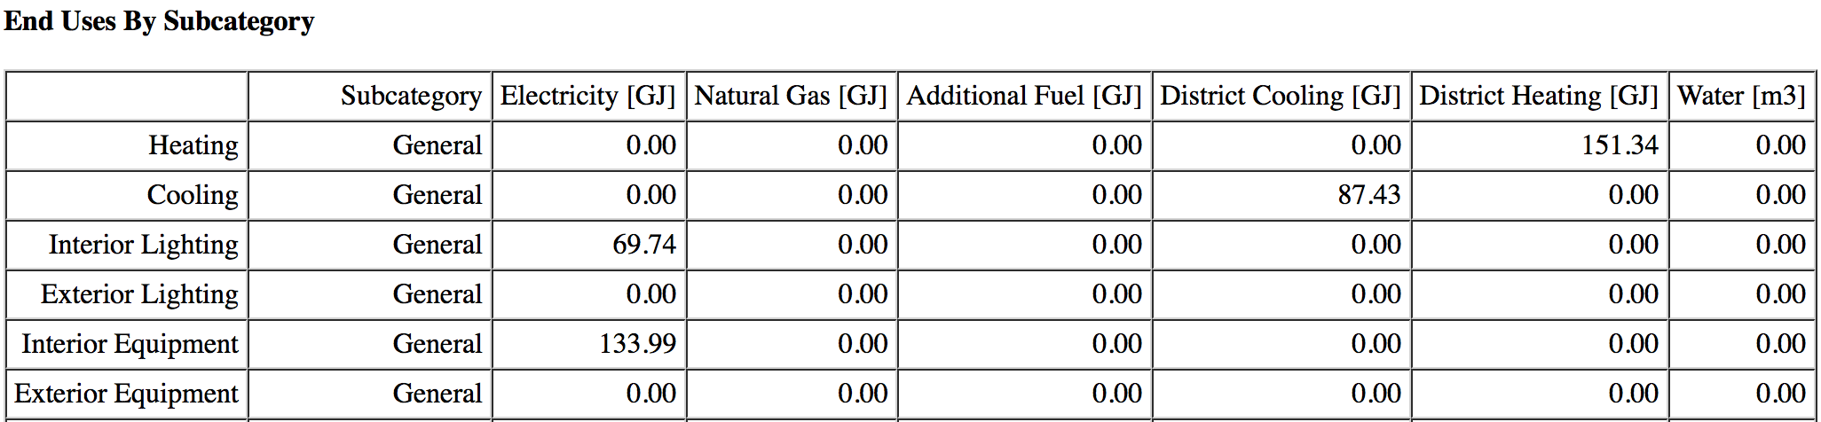
TECHNICAL ENVIRONMENT SYSTEMS-REPORT
PIACENZA-BASIC WALL
BASIC WALL : Stucco (2,5cm) / Concrete (20cm) / Insulation (3cm) / Gypsum (1.3cm)

Slide 7
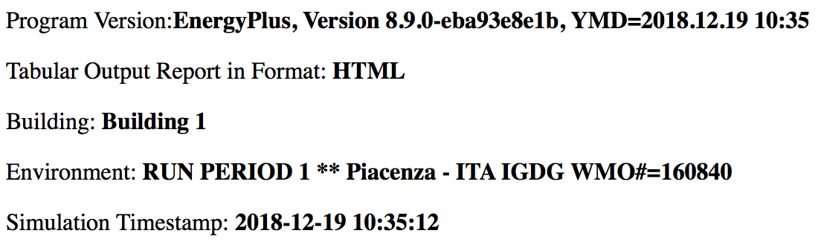
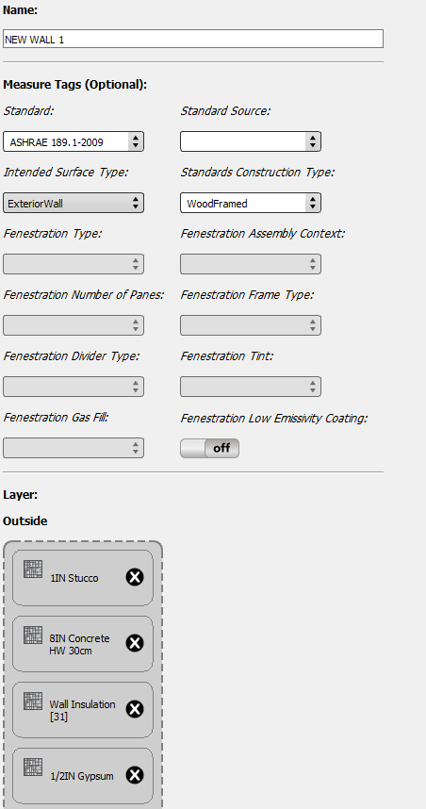
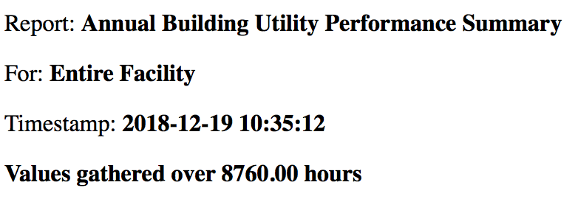
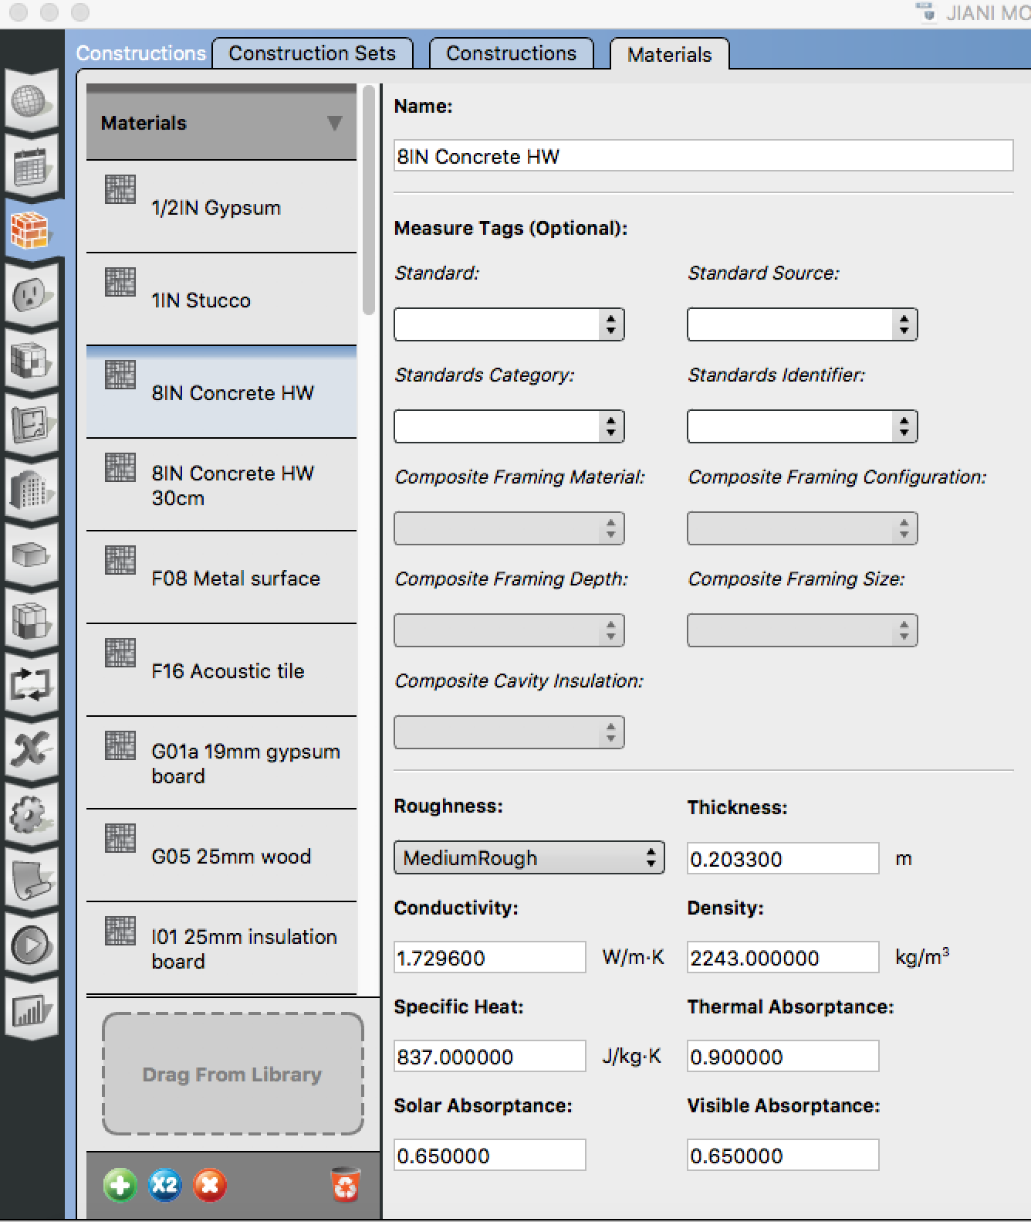
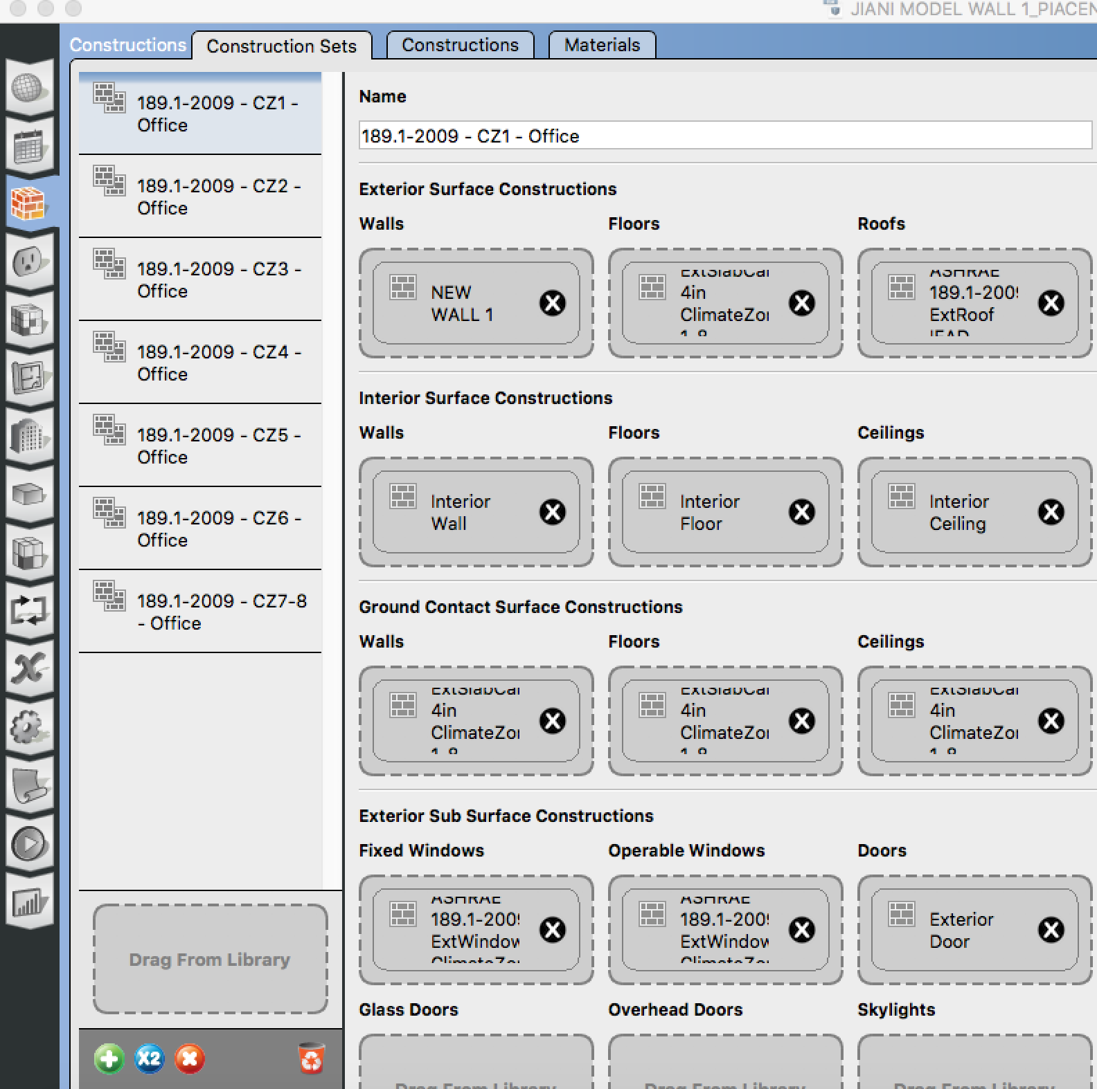
TECHNICAL ENVIRONMENT SYSTEMS-REPORT
PIACENZA-WALL 1
NEW WALL 1 : Stucco (2,5cm) / Concrete (30cm) / Insulation (3cm) / Gypsum (1.3cm)

Slide 8
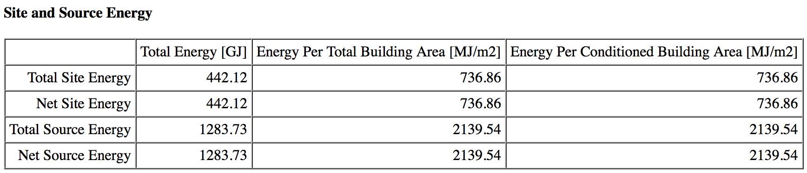
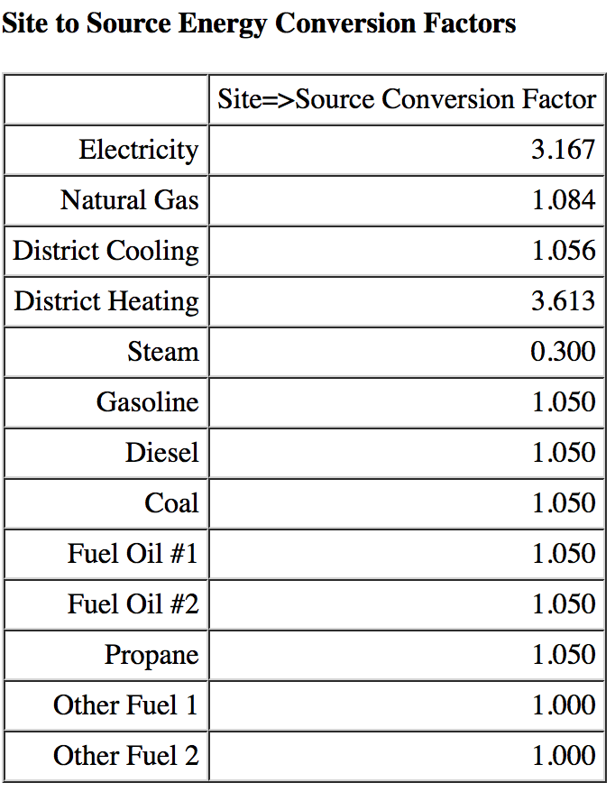
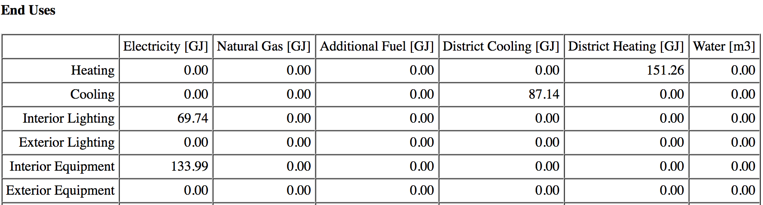
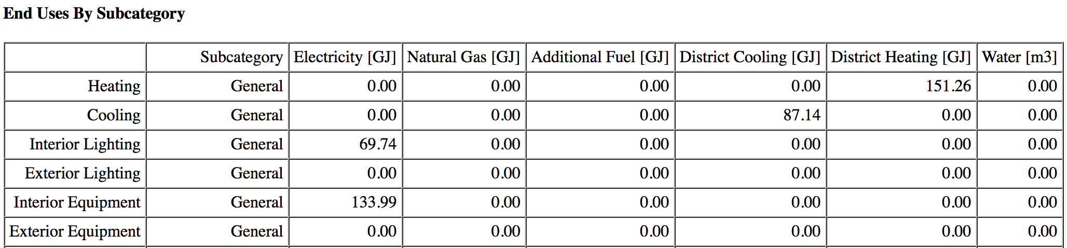
TECHNICAL ENVIRONMENT SYSTEMS-REPORT
PIACENZA-WALL 1
NEW WALL 1 : Stucco (2,5cm) / Concrete (30cm) / Insulation (3cm) / Gypsum (1.3cm)

Slide 9
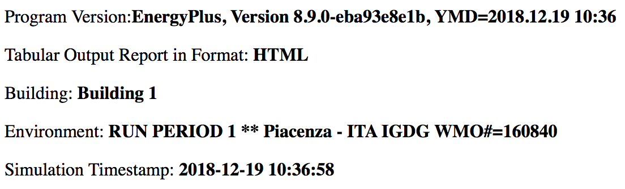
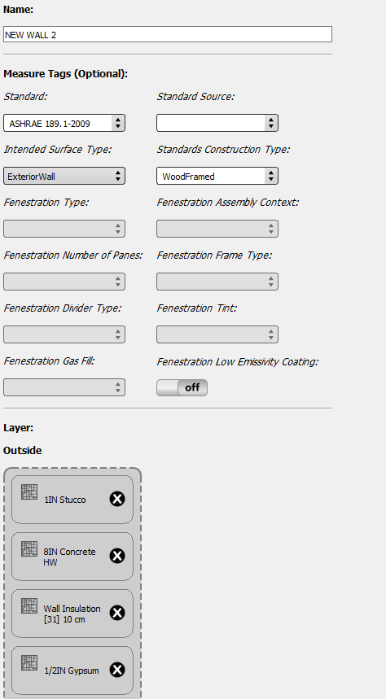



TECHNICAL ENVIRONMENT SYSTEMS-REPORT
PIACENZA-WALL 2
NEW WALL 2: Stucco (2,5cm) / Concrete (20cm) / Insulation (10cm) / Gypsum (1.3cm)

Slide 10
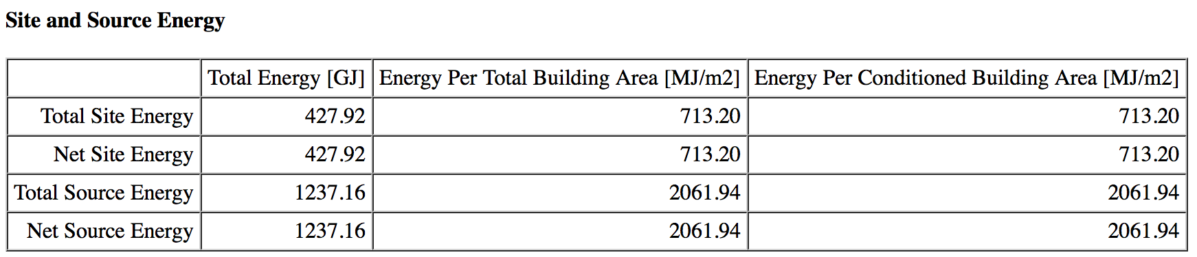
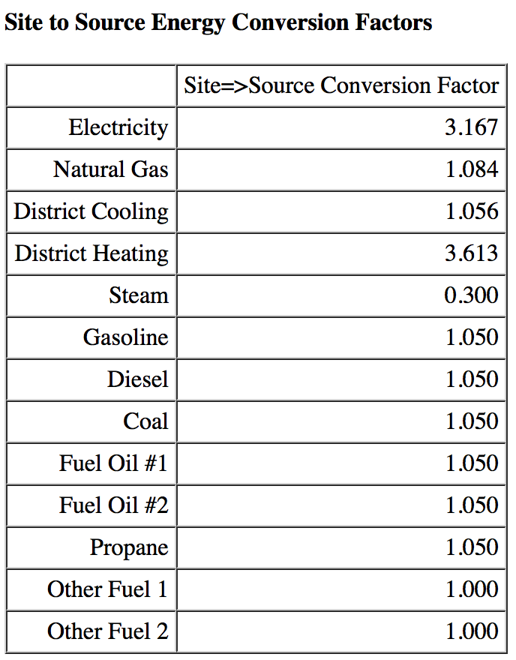
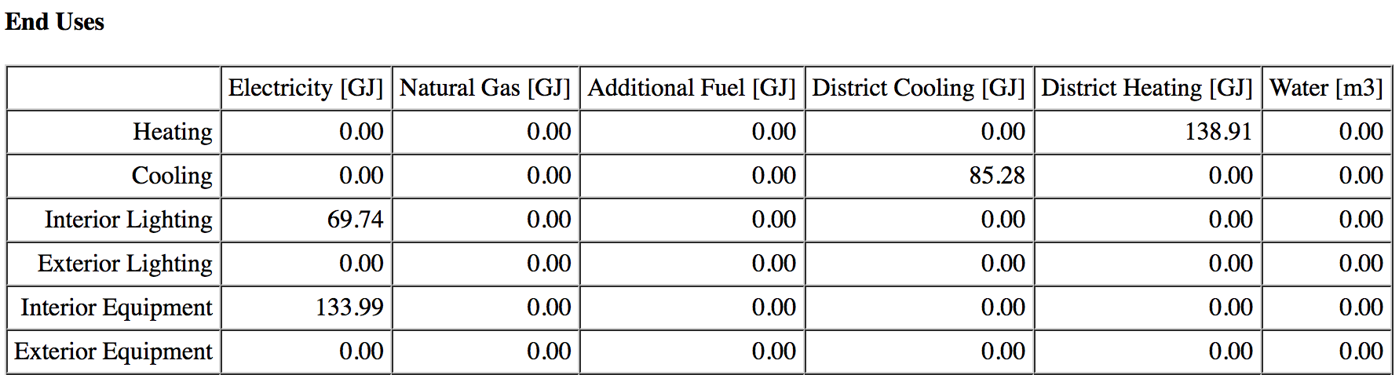
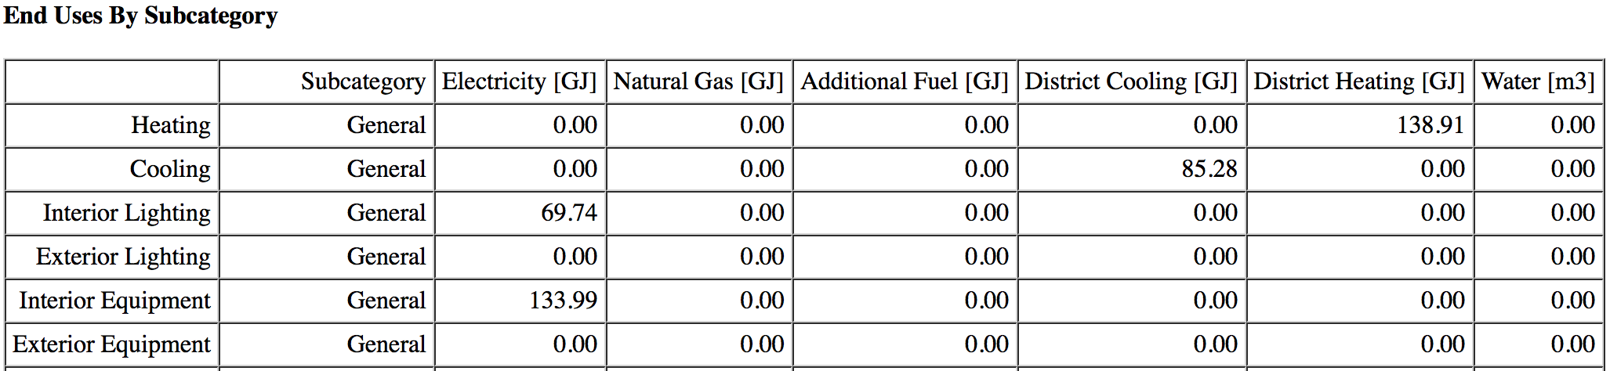
TECHNICAL ENVIRONMENT SYSTEMS-REPORT
PIACENZA-WALL 2
NEW WALL 2: Stucco (2,5cm) / Concrete (20cm) / Insulation (10cm) / Gypsum (1.3cm)

Slide 11
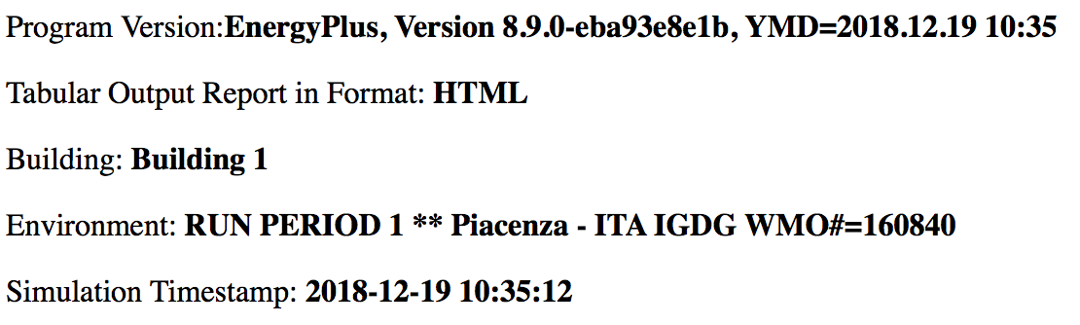

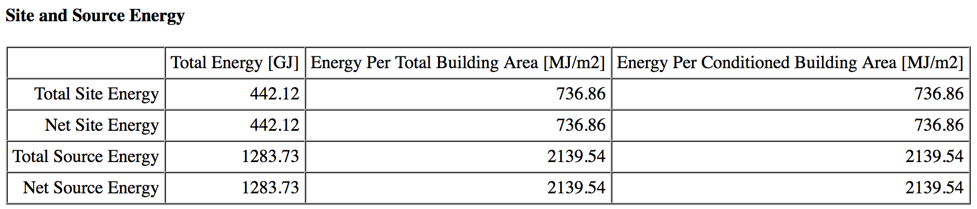
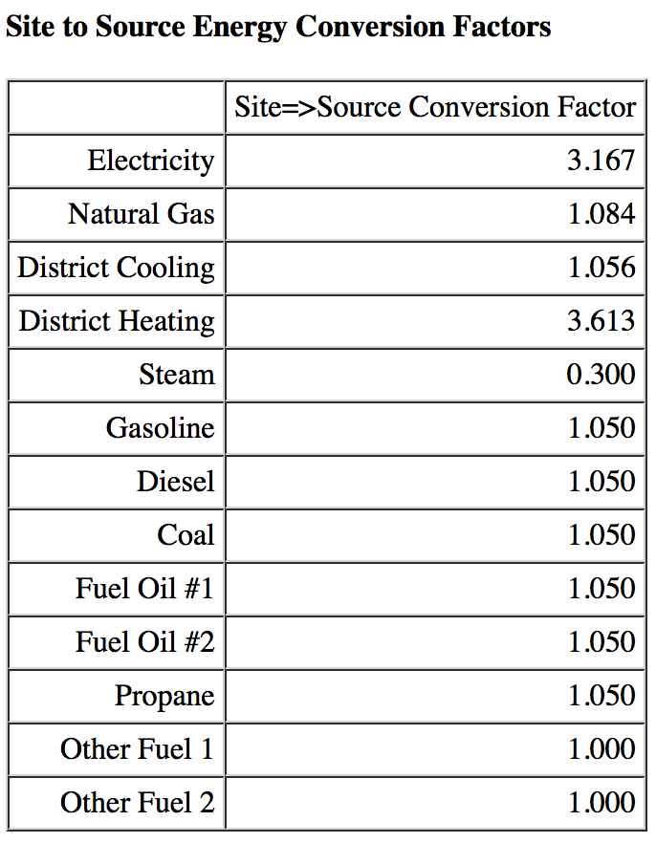

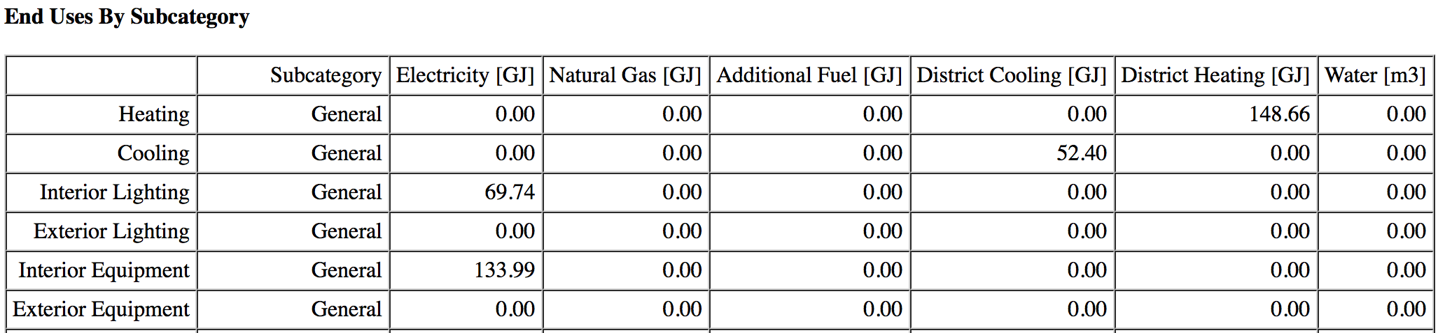
TECHNICAL ENVIRONMENT SYSTEMS-REPORT
PARIS-WALL 2
Stucco (2,5cm) / Concrete (20cm) / Insulation (10cm) / Gypsum (1.3cm)

Slide 12
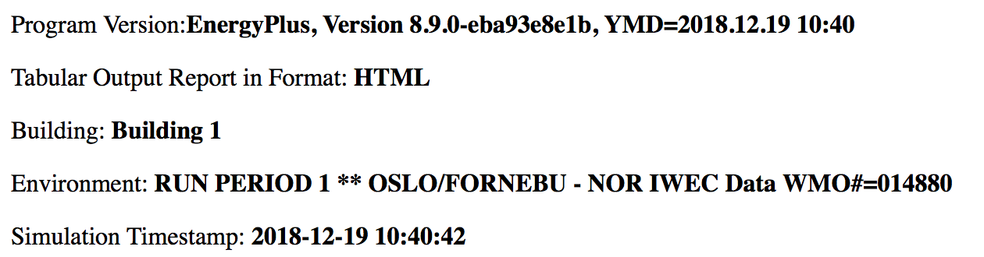


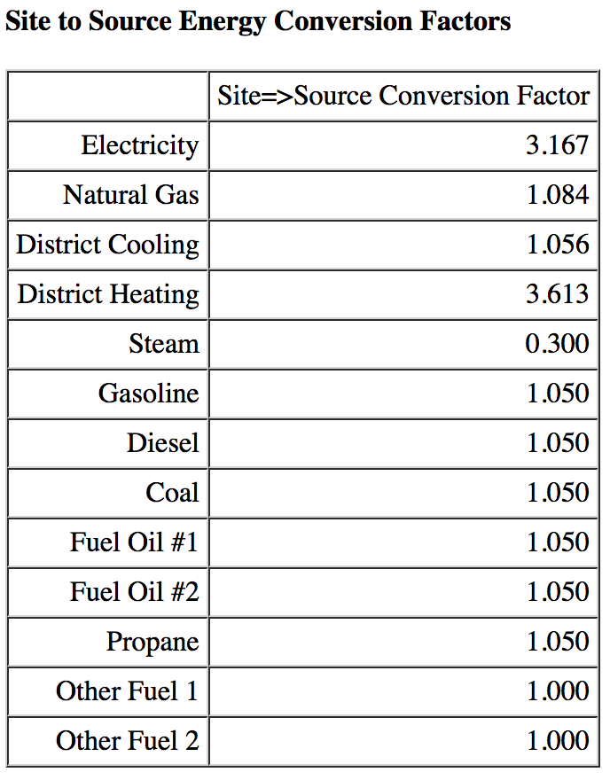

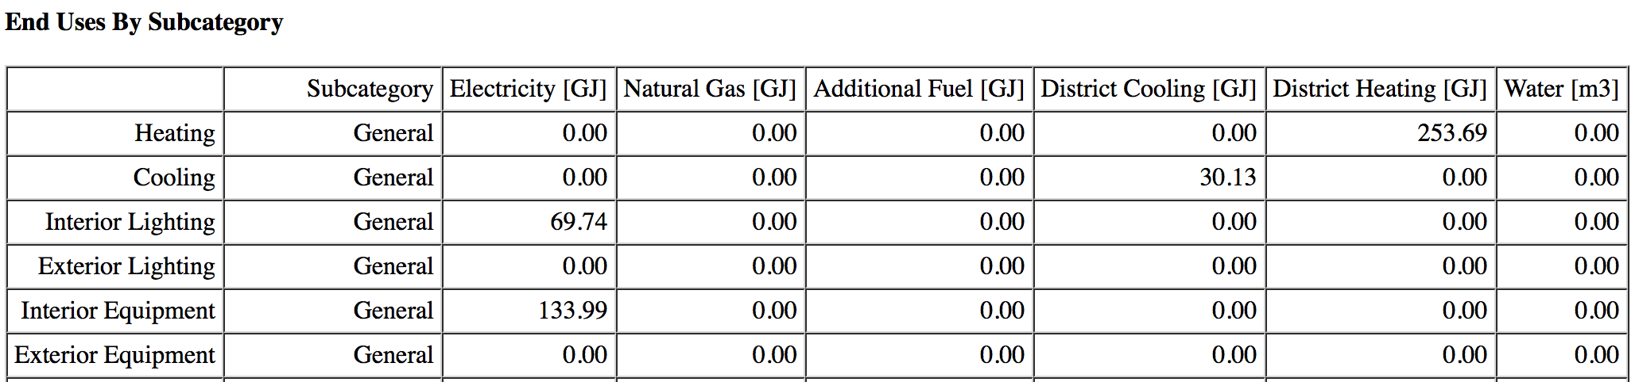
TECHNICAL ENVIRONMENT SYSTEMS-REPORT
OSLO-WALL 2
Stucco (2,5cm) / Concrete (20cm) / Insulation (10cm) / Gypsum (1.3cm)

Slide 13
TECHNICAL ENVIRONMENT SYSTEMS-REPORT
SUMMARY
TEST IN PIACENZA WITH THE 3 DIFFERENT WALLS
ENERGY USE | Total use (GJ) | Cooling (GJ) | Heating (GJ)
BASIC WALL | 442.49 | 87.43 | 151.34
NEW WALL 1 | 442.12 | 87.14 | 151.26
NEW WALL 2 | 427.92 | 85.28 | 138.91
TEST WITH WALL 2 IN 3 DIFFERENT CITIES
ENERGY USE | Total use (GJ) | Cooling (GJ) | Heating (GJ)
OSLO | 487.55 | 30.13 | 253.69
PARIS | 404.79 | 52.40 | 148.66
PIACENZA | 427.92 | 85.28 | 138.91

